Slide 1
Operating System Principle Chapter 1: Introduction
March 1, 2021

Slide 2
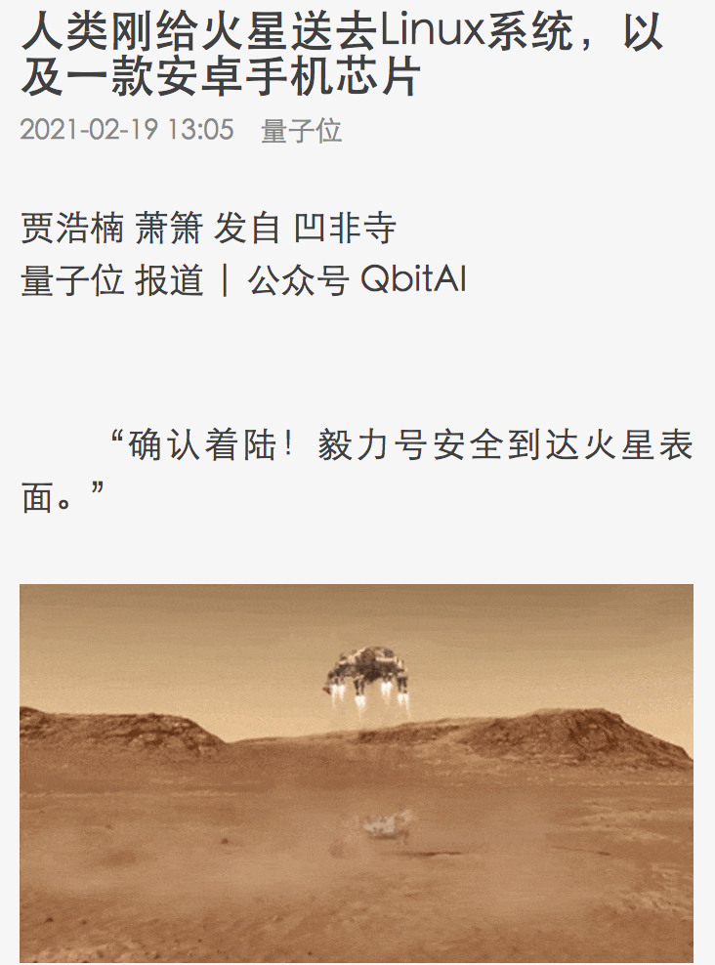
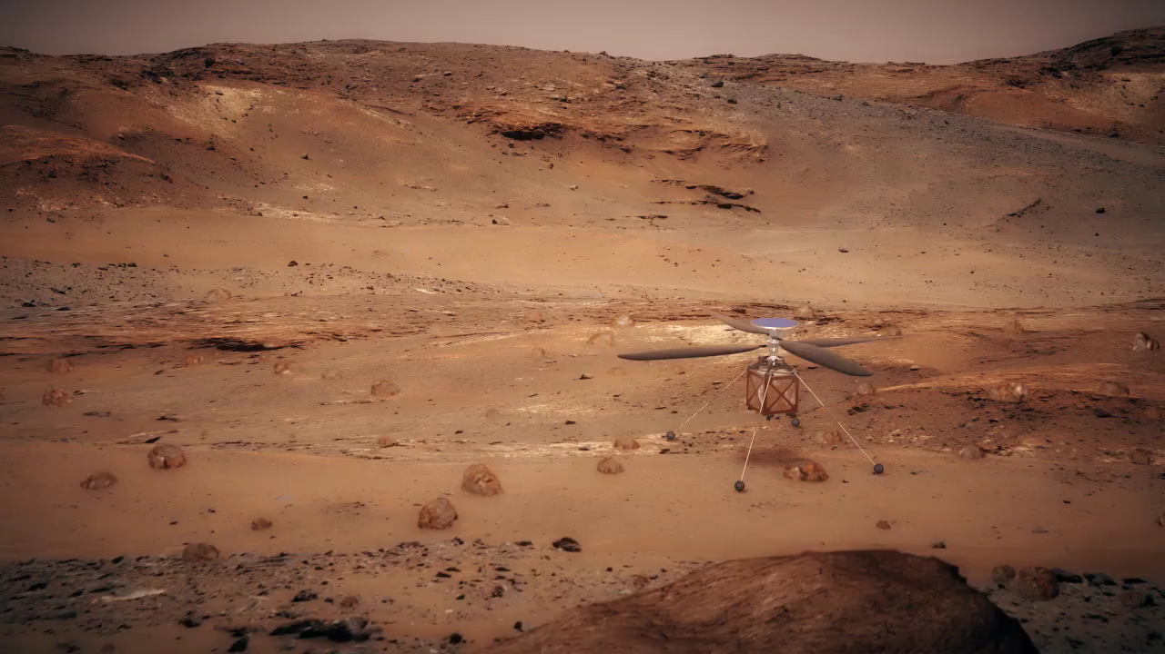
Operating System on Mars
https://mars.nasa.gov/technology/helicopter/
https://3g.163.com/dy/article/G36V8E030511DSSR.html?spss=adap_pc

Slide 3
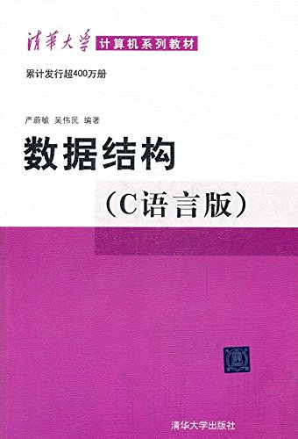
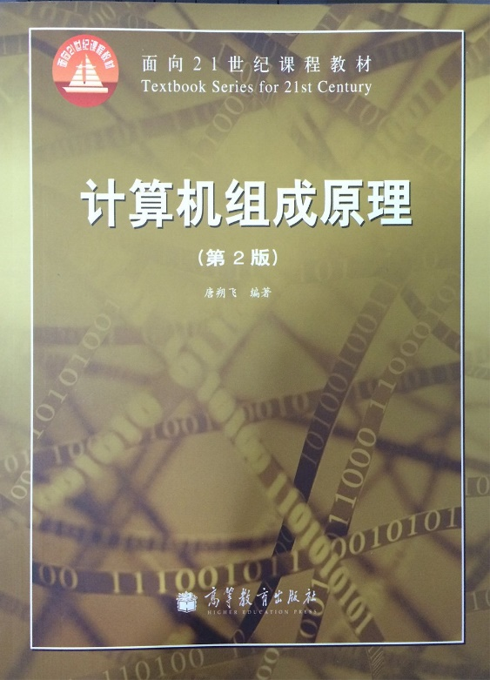
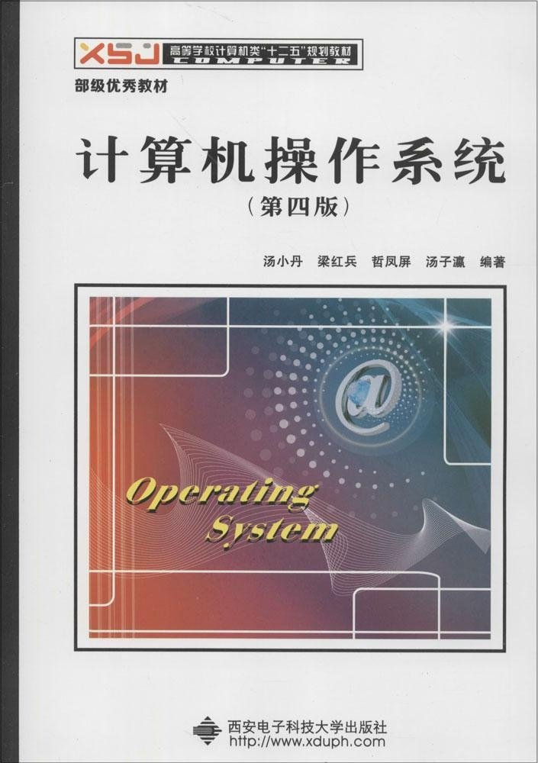
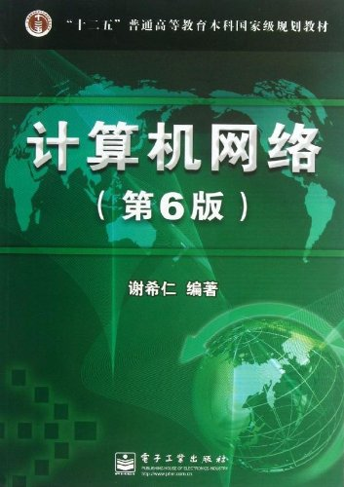
Welcome to OS

Slide 4
Prerequisites
Programming Language: C， Assembly
Data Structure
Organization of Computer System

Slide 5
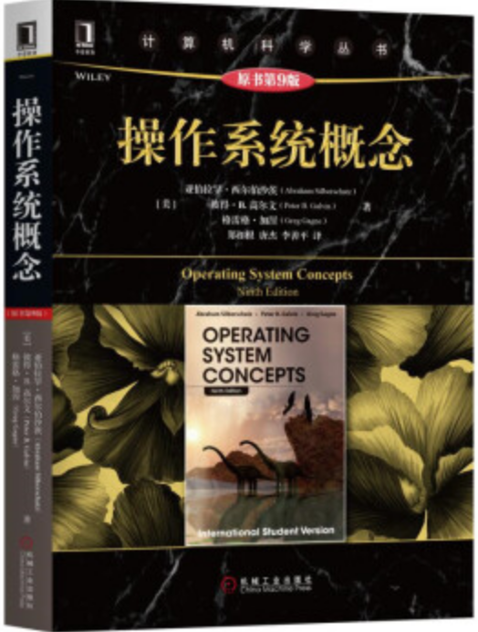
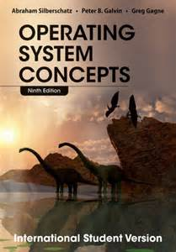
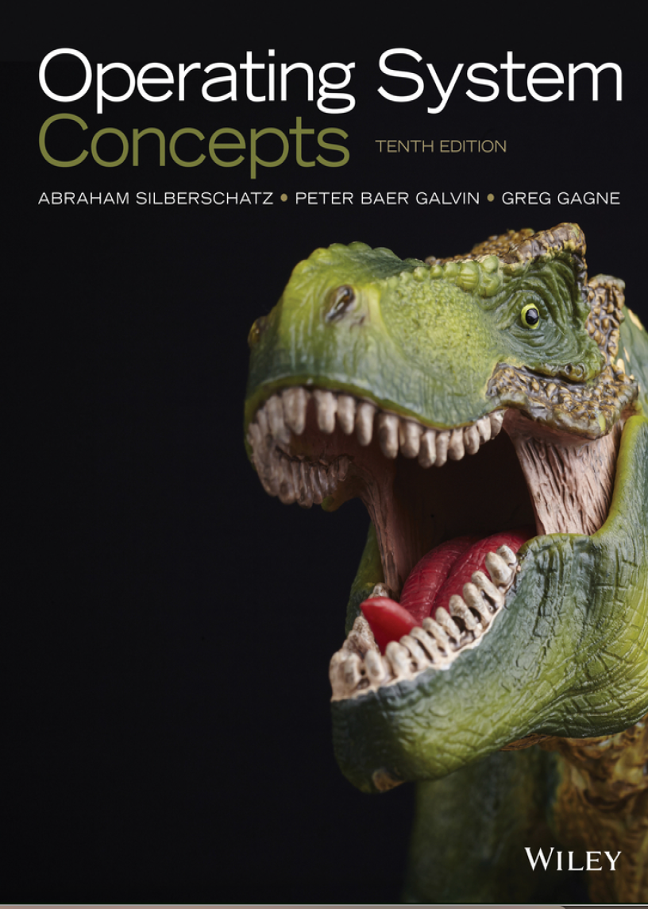
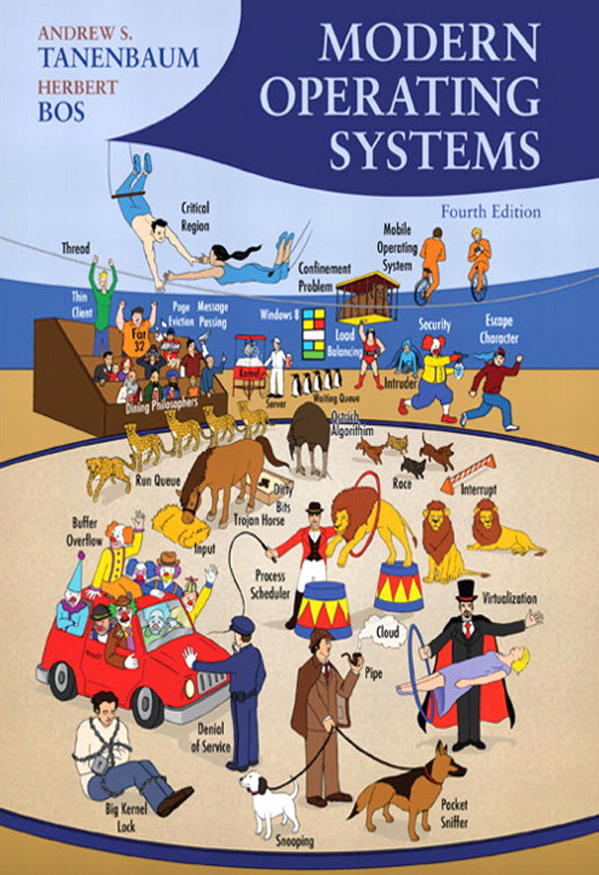
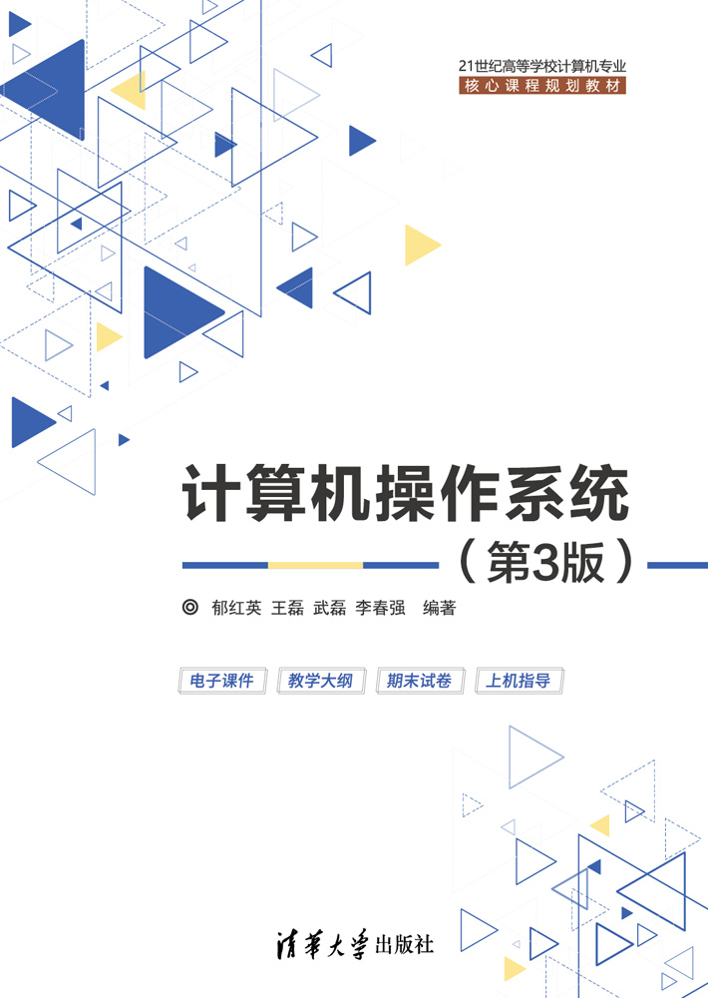
Textbooks
Operating System Concepts, 9th Edition. Abraham Silberschatz, Peter Baer Galvin, Greg Gagne, John Willey & Sons Inc. 2014
References
Modern Operating Systems, 4th Edition. Andrew S. Tanenbaum and Herbert Boss, Person Education, Inc., 2015
《计算机操作系统》(第3版)，郁红英 王磊等编著，清华大学出版社，2018

Slide 6
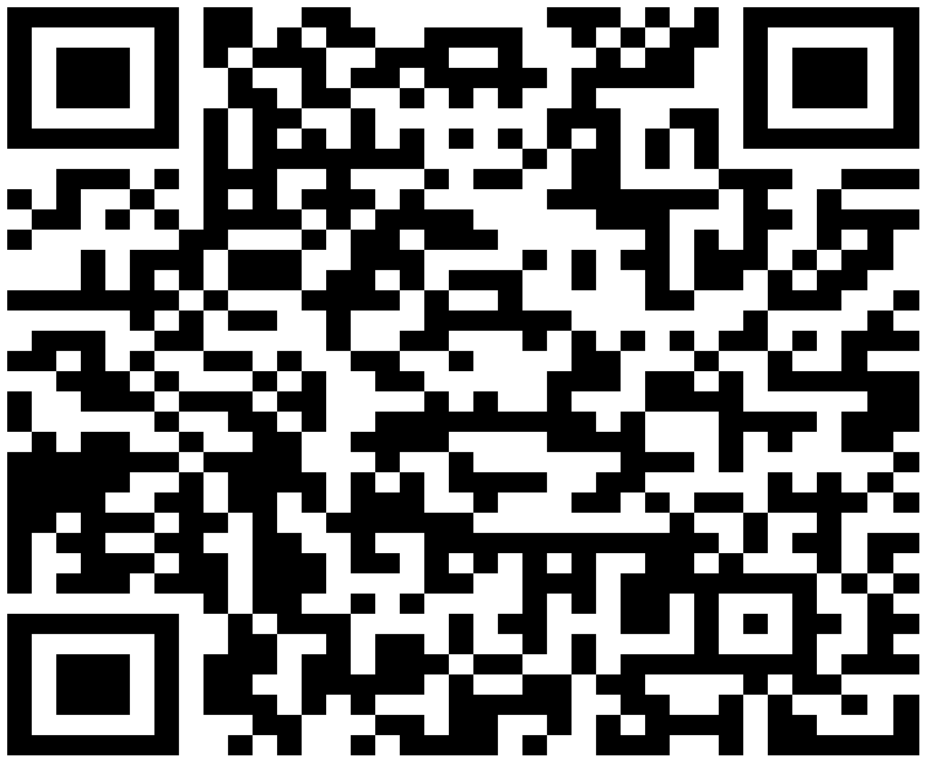
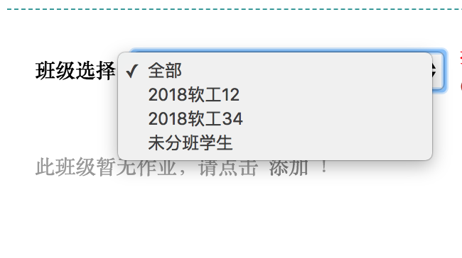
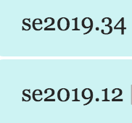
Exercises and Lab Reports
https://www.scholat.com/course/os2021
班级：
申请加入时请提供完整学号和姓名！

Slide 7
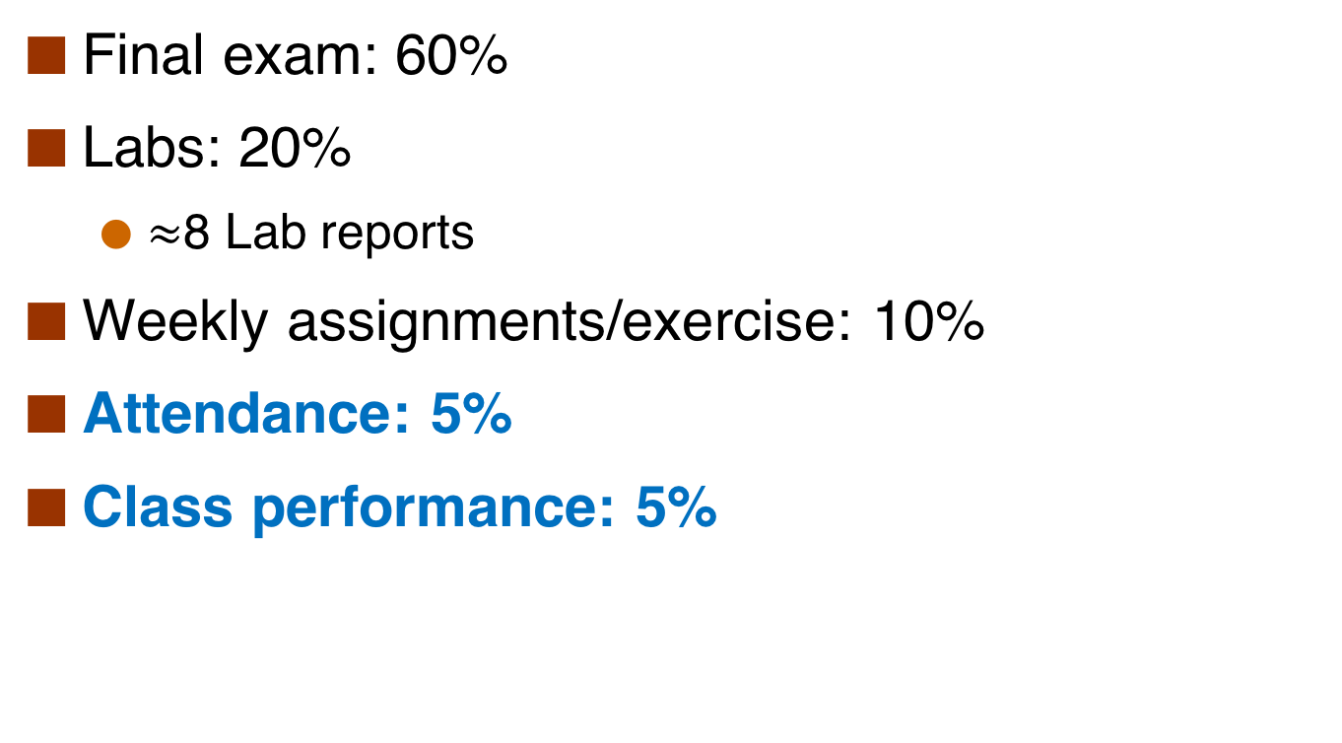
Evaluation
Final exam: 60%
Labs: 20%
$≈$8 Lab reports
Weekly assignments/exercise: 10%
Attendance: 5%
Class performance: 5%

Slide 8
Contact
赵恒军
18302301799
zhaohj2016@swu.edu.cn

Slide 9
Chapter 1: Introduction
What is operating system
The organization of computer system
The main functionality of operating system
The development history of operating system

Slide 10
Objectives
To introduce the definition and functionality of operating systems
To describe the basic organization of computer systems
interrupt
To provide a grand tour of the major components of operating systems

Slide 11
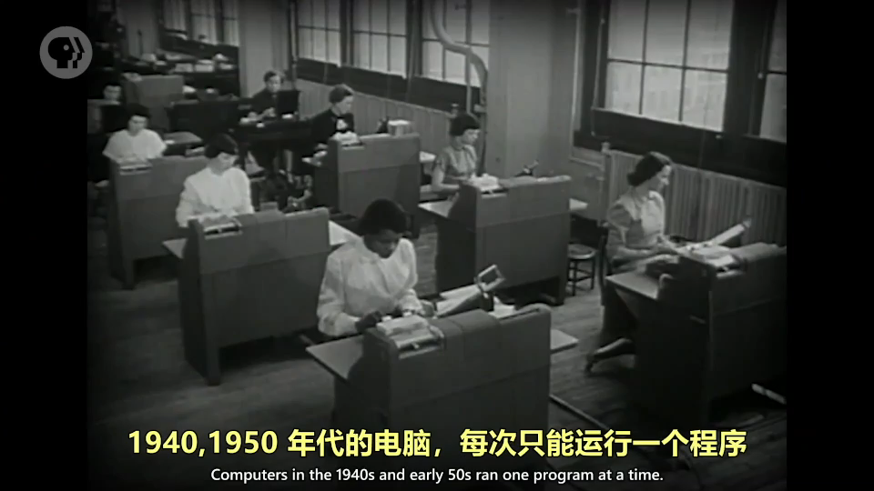
What is an Operating System?
Video

Slide 12
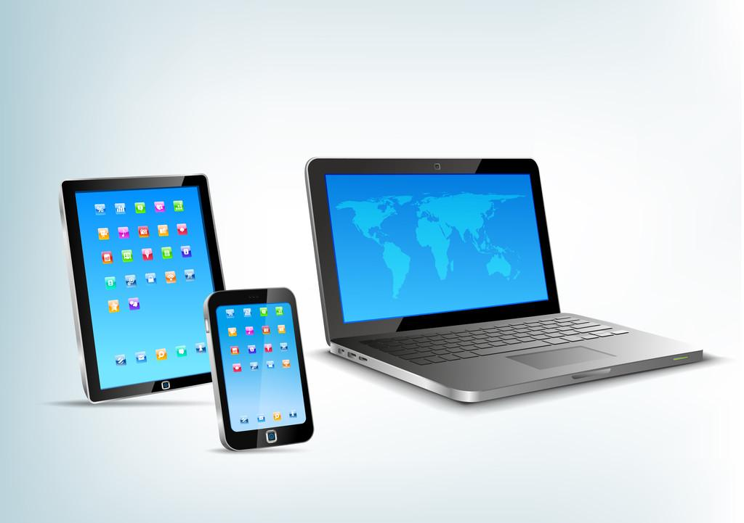
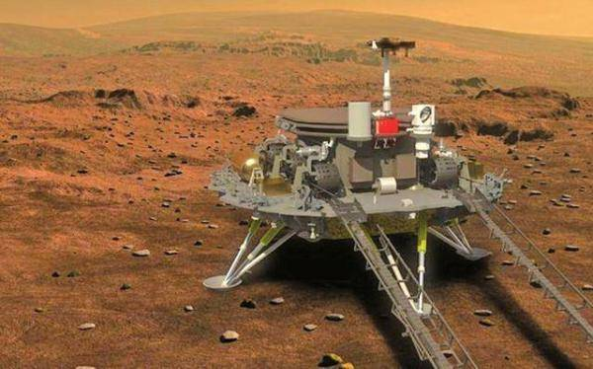
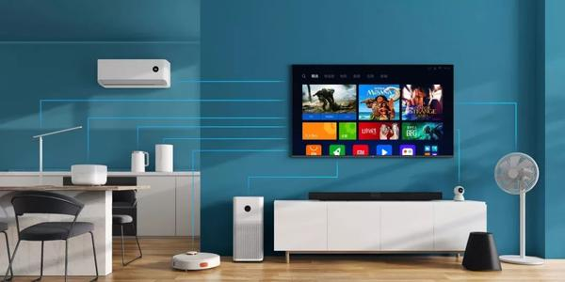
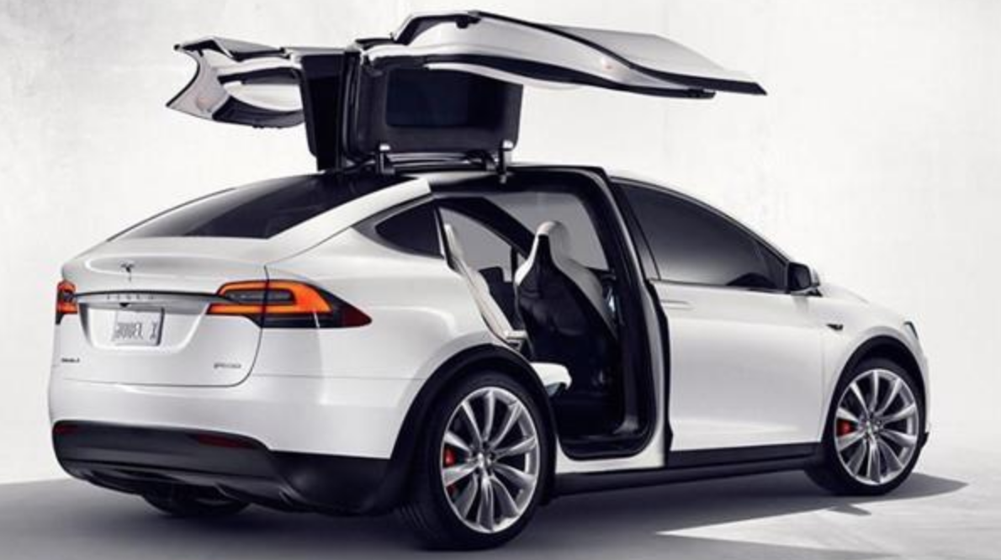
Modern Operating Systems

Slide 13
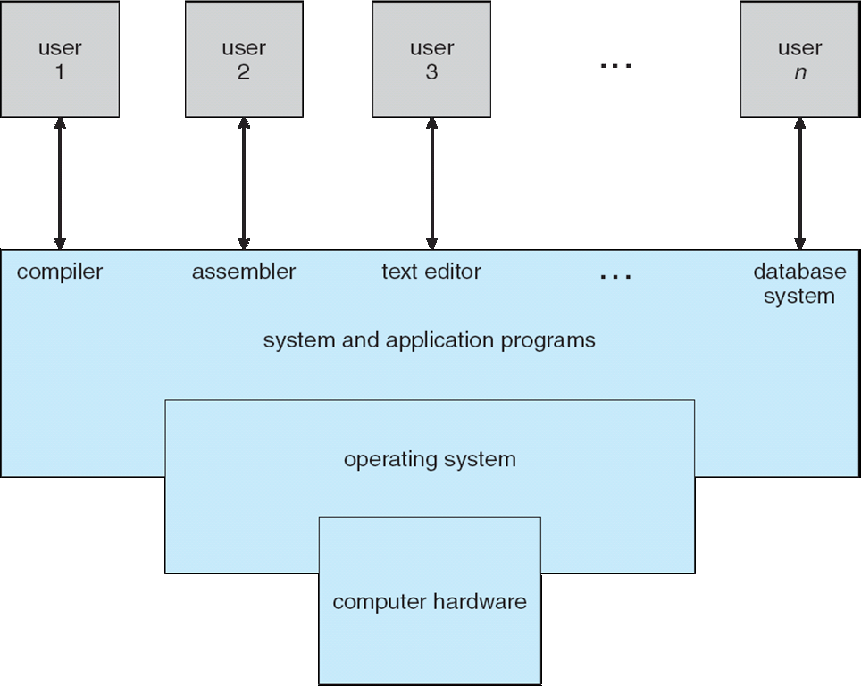
Four Components of a Computer System

Slide 14
Computer System Structure
Computer system can be divided into four components:
Hardware – provides basic computing resources
CPU, memory, I/O devices
Operating system
Controls and coordinates use of hardware among various applications and users
Application programs – define the ways in which the system resources are used to solve the computing problems of the users
Word processors, compilers, web browsers, database systems, video games
Users
People, machines, other computers

Slide 15
What is an Operating System?
An operating system is a program that manages a computer’s hardware.
It also provides a basis for application programs and
Acts as an intermediary between the computer user and the computer hardware.

Slide 16
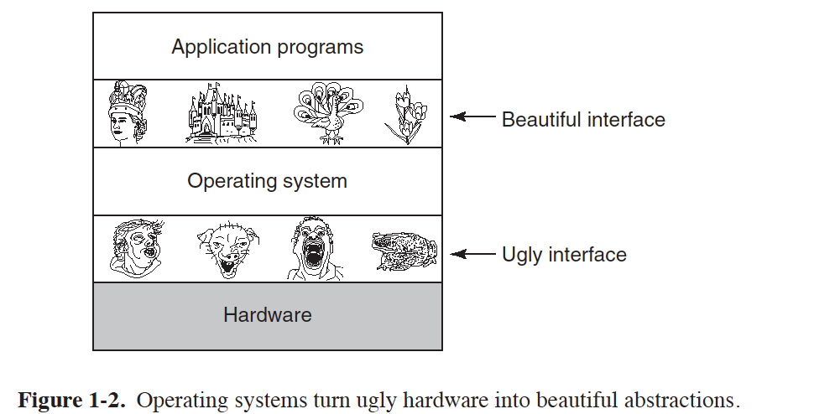
From A User’s View
Users want convenience, ease of use and good performance
Notes:
便捷性

Slide 17
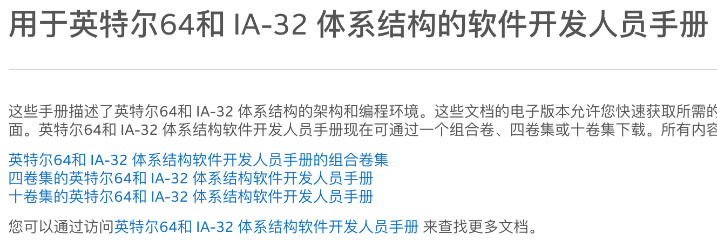
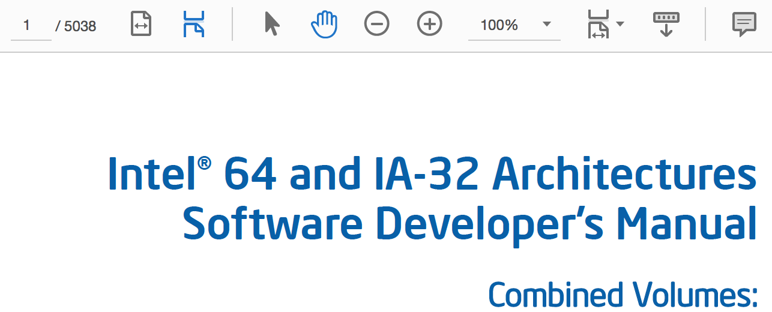
Intel Software Developer’s Manual
Notes:
便捷性

Slide 18
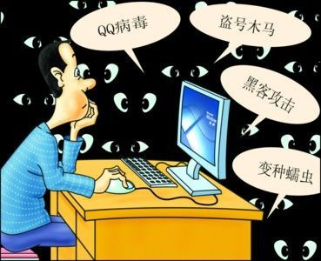
Security View
OS is a control program
Controls execution of programs to prevent errors and improper use of the computer
Notes:
安全性

Slide 19
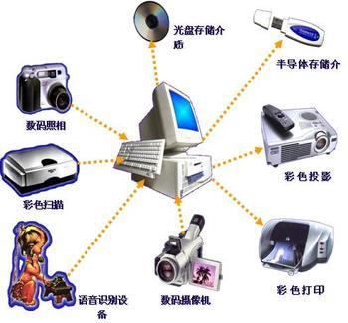
Resource View
OS is a resource allocator
Manages all resources
Decides between conflicting requests for efficient and fair resource use
Notes:
公平性、高效性

Slide 20
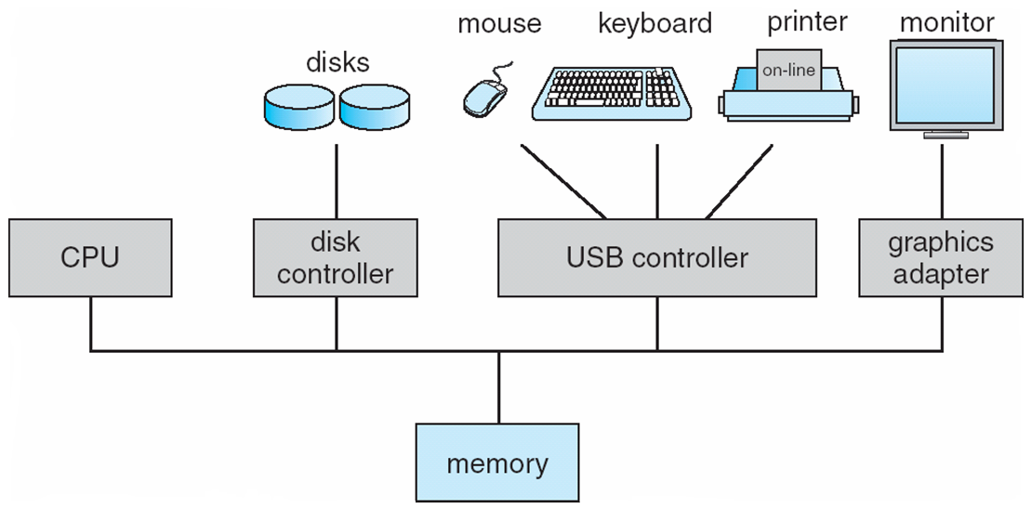
Computer System Organization
Computer-system operation
One or more CPUs, device controllers connect through common bus providing access to shared memory
Concurrent execution of CPUs and devices competing for memory cycles
Video
Notes:
organization.mp4
https://www.jianshu.com/p/defc60406dc1

Slide 21
Computer System Organization
CPU
Register file
ALU
PC
System bus
Memory bus
Main
memory
Bus interface
I/O
bridge
I/O bus
Expansion slots for
other devices such
as network adapters
USB
controller
Graphics
adapter
Disk
controller
Mouse
Keyboard
Display
Disk

Slide 22
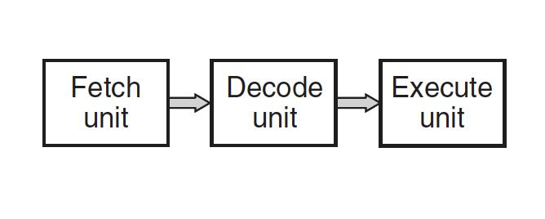
CPU
CPU chip
PC
Register file
ALU
Cache
memories
System bus
Memory bus
Main
memory
Bus interface
I/O
bridge
CPU： 2.70 GHz

Slide 23
Pipeline

Slide 24
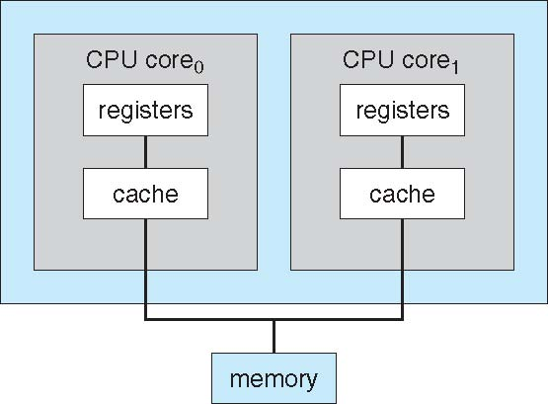
Multicore

Slide 25
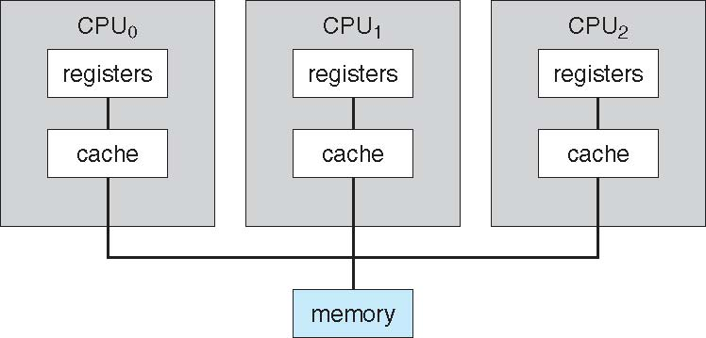
Multiprocessor

Slide 26
Storage Structure
Main memory – only large storage media that the CPU can access directly
Random access
Typically volatile
Secondary storage – extension of main memory that provides large nonvolatile storage capacity
Hard disks – rigid metal or glass platters covered with magnetic recording material
Disk surface is logically divided into tracks, which are subdivided into sectors
The disk controller determines the logical interaction between the device and the computer
Solid-state disks – faster than hard disks, nonvolatile
Various technologies
Becoming more popular

Slide 27
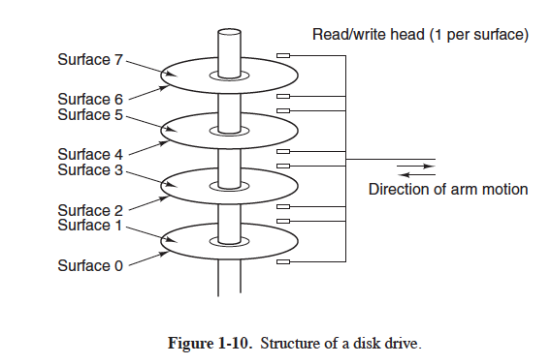
Hard Disk

Slide 28
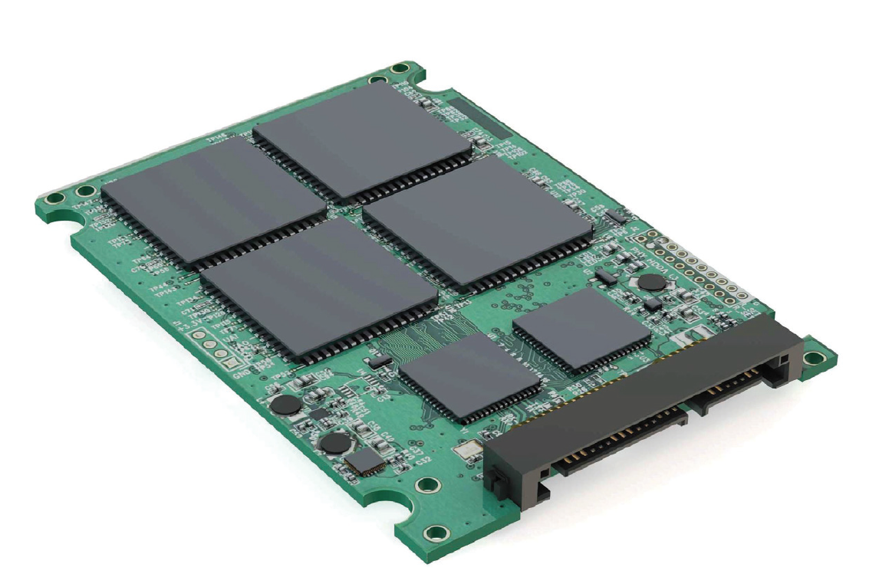
SSD

Slide 29
Storage Definitions and Notation Review
The basic unit of computer storage is the bit.
A byte is 8 bits, and on most computers it is the smallest convenient chunk of storage.
A less common term is word, which is a given computer architecture’s native unit of data. A computer executes many operations in its native word size rather than a byte at a time.
Computer storage, along with most computer throughput, is generally measured and manipulated in bytes and collections of bytes.
A kilobyte, or KB, is 1,024 bytes
a megabyte, or MB, is 1,024² bytes
a gigabyte, or GB, is 1,024³ bytes
a terabyte, or TB, is 1,024⁴ bytes
a petabyte, or PB, is 1,024⁵ bytes
Notes:
https://www.cnblogs.com/yilang/p/11103061.html

Slide 30
Storage Hierarchy
Storage systems organized in hierarchy
Speed
Cost
Volatility

Slide 31
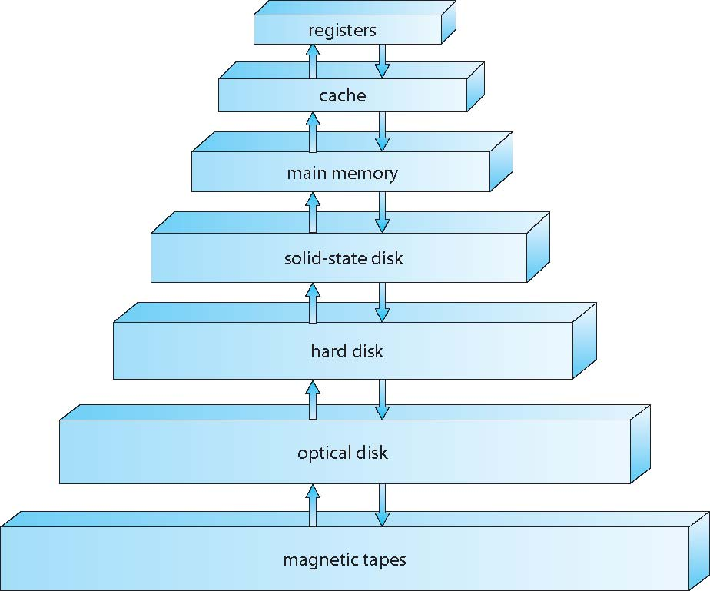
Storage-Device Hierarchy

Slide 32
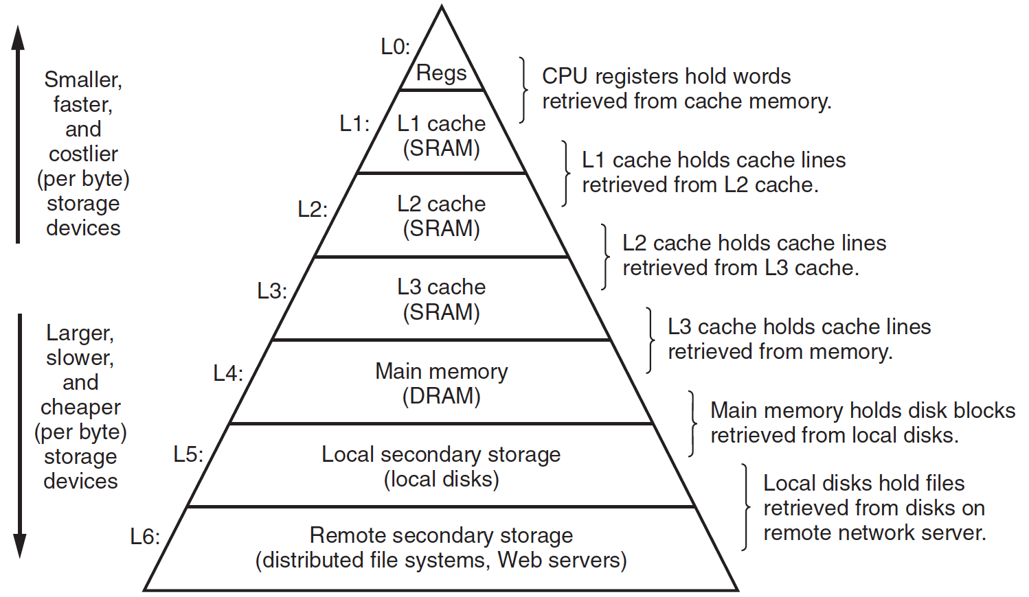
Storage-Device Hierarchy

Slide 33
Caching
Important principle, performed at many levels in a computer (in hardware, operating system, software)
Information in use copied from slower to faster storage temporarily
Faster storage (cache) checked first to determine if information is there
If it is, information used directly from the cache (fast)
If not, data copied to cache and used there
Cache smaller than storage being cached
Cache replacement policy

Slide 34
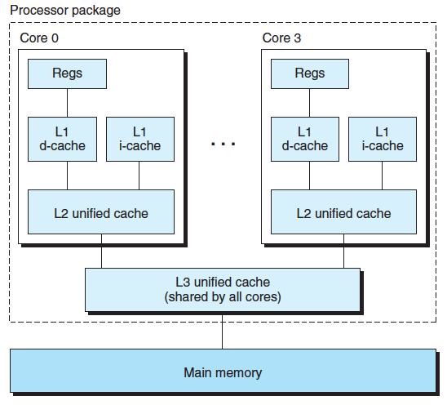
Three Levels of Cache on Multicore
Notes:
地球赤道的周长

Slide 35
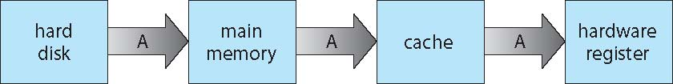
Migration of data ‘A’
Multitasking environments must be careful to use most recent value, no matter where it is stored in the storage hierarchy
Multiprocessor environment must provide cache coherency in hardware such that all CPUs have the most recent value in their cache

Slide 36
I/O Device
Devices
Device controller/adapter
Device Driver for each device controller to manage I/O
Provides uniform interface between controller and kernel

Slide 37
Write
CPU
Register file
ALU
PC
System bus
Memory bus
hello code
Main
memory
"hello,world\n"
Bus interface
I/O
bridge
I/O bus
Expansion slots for
other devices such
as network adapters
USB
controller
Graphics
adapter
Disk
controller
Mouse
Keyboard
Display
Disk
hello executable
stored on disk
"hello,world\n"
Notes:
寄存器堆

Slide 38
Read
CPU
Register file
ALU
PC
System bus
Memory bus
Main
memory
"hello"
Bus interface
I/O
bridge
I/O bus
Expansion slots for
other devices such
as network adapters
USB
controller
Graphics
adapter
Disk
controller
Mouse
Keyboard
Display
Disk
User types
"hello"

Slide 39
Direct Memory Access Structure
CPU
Register file
ALU
PC
System bus
Memory bus
hello code
Main
memory
"hello,world\n"
Bus interface
I/O
bridge
I/O bus
Expansion slots for
other devices such
as network adapters
USB
controller
Graphics
adapter
Disk
controller
Mouse
Keyboard
Display
Disk
hello executable
stored on disk

Slide 40
Think About
What happens when the computer has no task to do?
What is the first action you take to operate a computer to perform a certain task, e.g. to play a video?
Notes:
Inside your computer

Slide 41
Think About
What happens when the mouse button is clicked?
Video
Notes:
Inside your computer
Interrupt.mp4

Slide 42
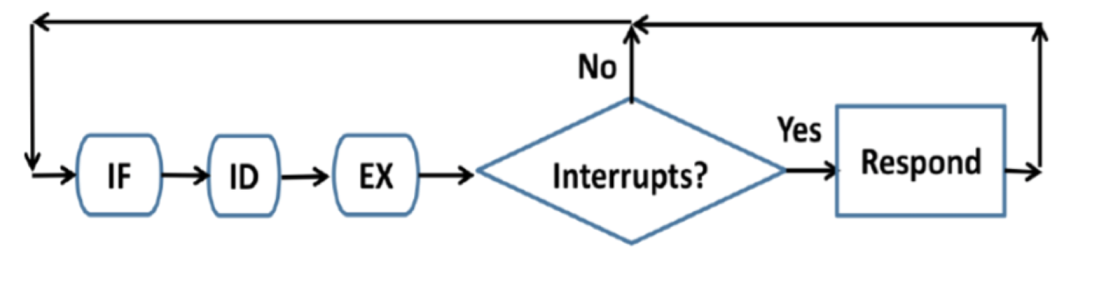
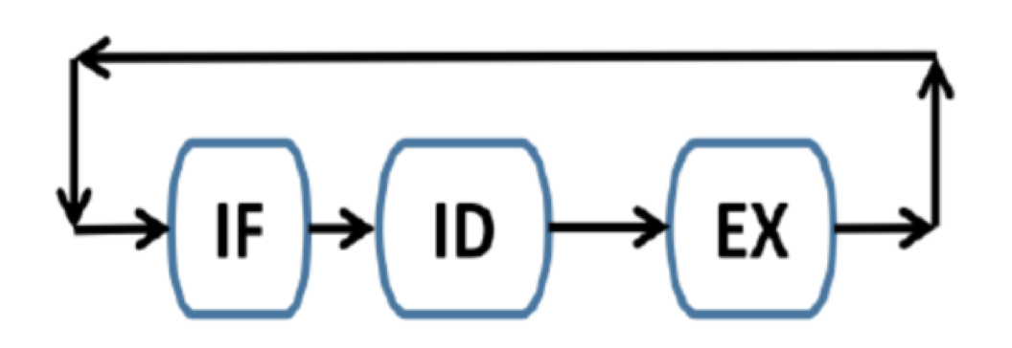
Interrupt
Program counter
Notes:
Interrupt pic overlappling

Slide 43
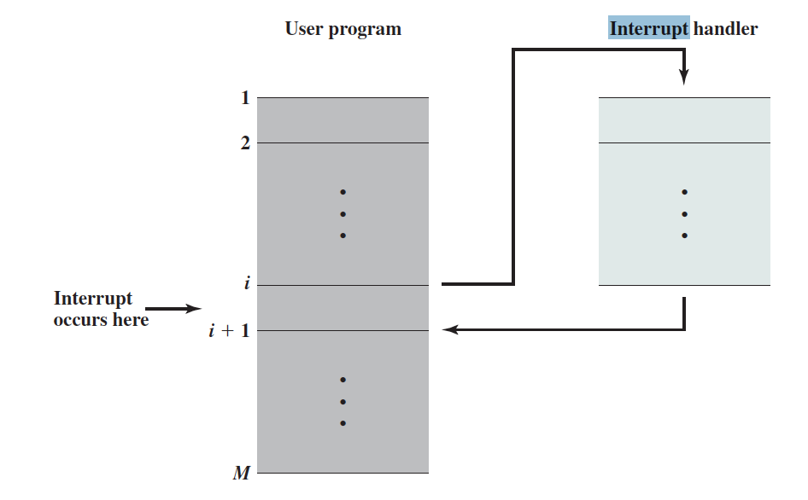
Interrupt Processing

Slide 44
Interrupt Vector
Interrupt vector table
Interrupt descriptor table
Interrupt service routine

Slide 45
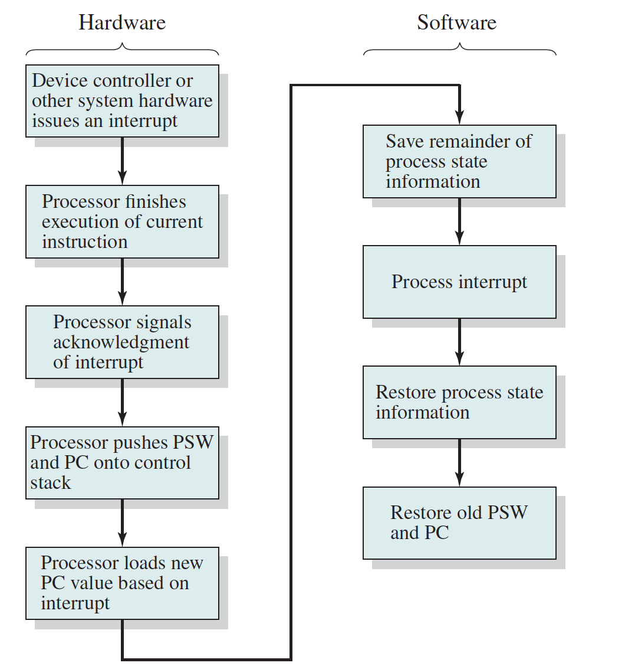
Context Save
Notes:
pc, sp, psw

Slide 46
Interrupt driven
Interrupt driven (hardware and software)
Hardware interrupt by one of the devices
Software interrupt (exception or trap):
Software error (e.g., division by zero)
Request for operating system service
Other process problems include infinite loop, processes modifying each other or the operating system

Slide 47
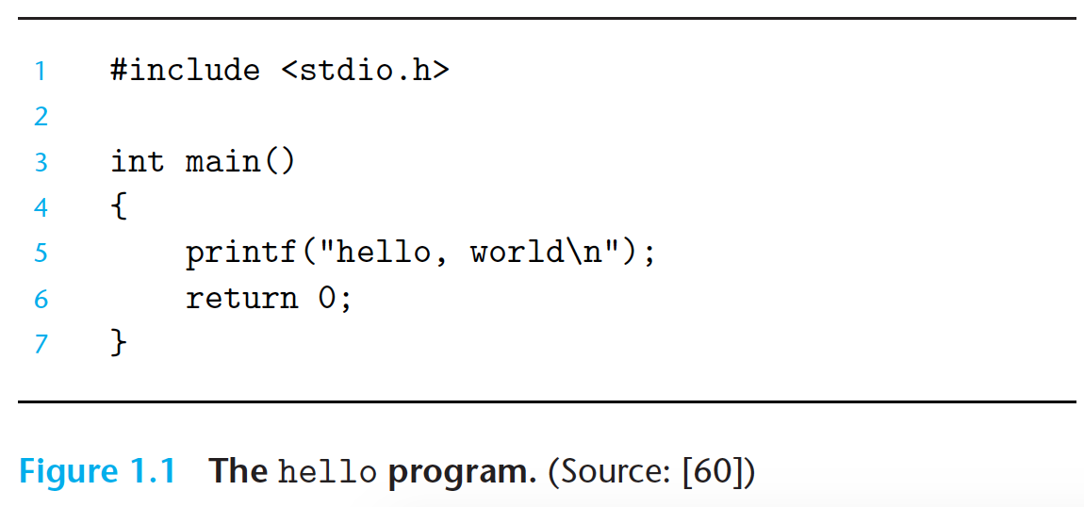
Hello World
Notes:
使用helloworld编写、存储、编译、运行的例子展示操作系统的几大功能

Slide 48
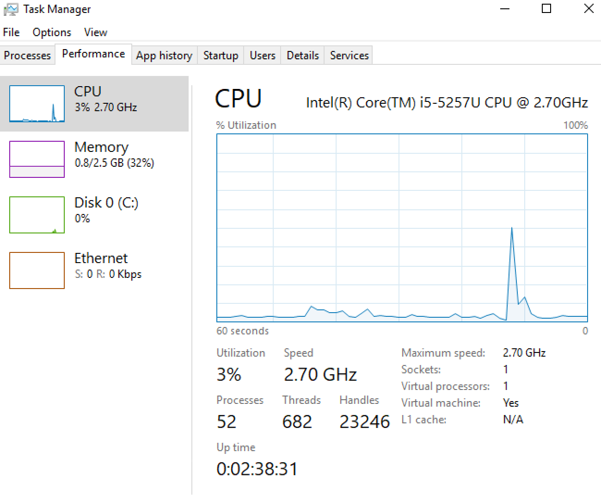
Functionality of OS
Windows 10
Demonstration
Notes:
文件树
设备管理器

Slide 49
Process Management
A process is a program in execution. It is a unit of work within the system. Program is a passive entity, process is an active entity.
Process needs resources to accomplish its task
CPU, memory, I/O, files
Initialization data
Process termination requires reclaim of any reusable resources
Single-threaded process has one program counter specifying location of next instruction to execute
Process executes instructions sequentially, one at a time, until completion
Multi-threaded process has one program counter per thread
Typically system has many processes, some user, some operating system running concurrently on one or more CPUs
Concurrency by multiplexing the CPUs among the processes / threads

Slide 50
Process Management Activities
The operating system is responsible for the following activities in connection with process management:
Creating and deleting both user and system processes
Suspending and resuming processes
Providing mechanisms for process synchronization
Providing mechanisms for process communication
Providing mechanisms for deadlock handling

Slide 51
Memory Management
To execute a program all (or part) of the instructions must be in memory
All (or part) of the data that is needed by the program must be in memory.
Memory management determines what is in memory and when
Optimizing CPU utilization and computer response to users
Memory management activities
Keeping track of which parts of memory are currently being used and by whom
Deciding which processes (or parts thereof) and data to move into and out of memory
Allocating and deallocating memory space as needed

Slide 52
Storage Management
OS provides uniform, logical view of information storage
Abstracts physical properties to logical storage unit - file
Each medium is controlled by device (i.e., disk drive, tape drive)
Varying properties include access speed, capacity, data-transfer rate, access method (sequential or random)
File-System management
Files usually organized into directories
Access control on most systems to determine who can access what
OS activities include
Creating and deleting files and directories
Primitives to manipulate files and directories
Mapping files onto secondary storage
Backup files onto stable (non-volatile) storage media

Slide 53
Mass-Storage Management
Usually disks used to store data that does not fit in main memory or data that must be kept for a “long” period of time
Proper management is of central importance
Entire speed of computer operation hinges on disk subsystem and its algorithms
OS activities
Free-space management
Storage allocation
Disk scheduling
Some storage need not be fast
Tertiary storage includes optical storage, magnetic tape
Still must be managed – by OS or applications
Varies between WORM (write-once, read-many-times) and RW (read-write)

Slide 54
I/O Subsystem
One purpose of OS is to hide peculiarities of hardware devices from the user
I/O subsystem responsible for
Memory management of I/O including buffering (storing data temporarily while it is being transferred), caching (storing parts of data in faster storage for performance), spooling (the overlapping of output of one job with input of other jobs)
General device-driver interface
Drivers for specific hardware devices

Slide 55
Contents
Chapter 1
Chapter 2
Chapter 3
Chapter 4
Chapter 5
Chapter 6
Chapter 7
Chapter 8
Chapter 9
Chapter 10
Chapter 11
Chapter 12
Chapter 13

Slide 56

During This Course

Slide 57
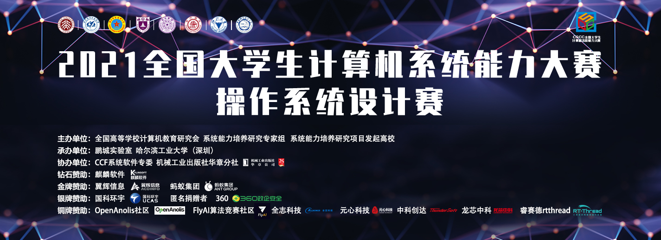
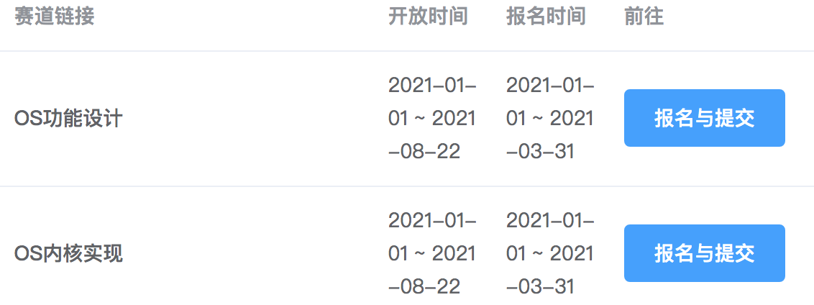
Competition
OS 2021
https://os.educg.net/

Slide 58
Homework
https://www.scholat.com/course/os2021
班级：
申请加入时请提供完整学号和姓名！

Slide 59
End of Chapter 1
Questions?

Slide 60
Operating System Development
Multiprogramming needed for efficiency
Single user cannot keep CPU and I/O devices busy at all times
Multiprogramming organizes jobs (code and data) so CPU always has one to execute
A subset of total jobs in system is kept in memory
One job selected and run via job scheduling
When it has to wait (for I/O for example), OS switches to another job
Video
Notes:
history

Slide 61
Timesharing
Timesharing (multitasking) is logical extension in which CPU switches jobs so frequently that users can interact with each job while it is running, creating interactive computing
Response time should be < 1 second
Each user has at least one program executing in memory process
If several jobs ready to run at the same time  CPU scheduling
If processes don’t fit in memory, swapping moves them in and out to run
Virtual memory allows execution of processes not completely in memory
Notes:
多道和分时的区别

Slide 62
Computing Environments - Traditional
Stand-alone general purpose machines
But blurred as most systems interconnect with others (i.e., the Internet)
Portals provide web access to internal systems
Network computers (thin clients) are like Web terminals

Slide 63
Computing Environments - Mobile
Handheld smartphones, tablets, etc
Extra feature – more OS features (GPS, gyroscope)
Use IEEE 802.11 wireless, or cellular data networks for connectivity
Leaders are Apple iOS and Google Android

Slide 64
Computing Environments – Distributed
Distributed computing
Collection of separate, possibly heterogeneous, systems networked together
Network is a communications path, TCP/IP most common
Local Area Network (LAN)
Wide Area Network (WAN)
Metropolitan Area Network (MAN)
Network Operating System provides features between systems across network
Communication scheme allows systems to exchange messages

Slide 65
Computing Environments – Cloud Computing
Delivers computing, storage, even apps as a service across a network
Logical extension of virtualization because it uses virtualization as the base for it functionality.
Many types
Public cloud – available via Internet to anyone willing to pay
Private cloud – run by a company for the company’s own use
Hybrid cloud – includes both public and private cloud components
Software as a Service (SaaS) – one or more applications available via the Internet (i.e., word processor)
Platform as a Service (PaaS) – software stack ready for application use via the Internet (i.e., a database server)
Infrastructure as a Service (IaaS) – servers or storage available over Internet (i.e., storage available for backup use)

